Slide 1
secure data hiding in image using steganography
CAPSTONE PROJECT
Presented By: Harshad Ajit Wable
Student Name : Harshad Wable
College Name & Department : S.V.P.M. College Of Engineering .
Malegaon BK.

Slide 2
OUTLINE
Problem Statement
Technology used
Wow factor
End users
Result
Conclusion
Git-hub Link
Future scope

Slide 3
Problem Statement
Traditional encryption methods often attract attention, making data transmissions susceptible to interception. This project implements Least Significant Bit (LSB) steganography to hide secret messages within images without altering their appearance. By subtly modifying pixel values, it ensures secure, invisible communication while preserving data confidentiality.

Slide 4
Technology used
Programming Language: Python
GUI Framework: Tkinter (for user interface)
Image Processing: Pillow (PIL) (to handle image operations)
Steganography Library: Stepic (for encoding and decoding messages)
File Handling: filedialog (to select images from the system)
Error Handling & Notifications: messagebox (for user alerts)

Slide 5
Wow factors
User-Friendly GUI – A simple and intuitive interface built with Tkinter, making it accessible to all users.
Invisible Data Hiding – Uses LSB steganography, ensuring that the hidden message remains undetectable to the human eye.
Multi-Format Support – Works with PNG, JPG, and JPEG images for flexibility.
Instant Encoding & Decoding – Quickly hides and retrieves messages with just a few clicks.
Secure Communication – Provides a covert way to share sensitive information without raising suspicion.
Lightweight & Efficient – Small application size with fast processing, making it ideal for various use cases.

Slide 6
End users
Cybersecurity Professionals – For secure and covert data transmission.
Intelligence Agencies & Law Enforcement – To communicate sensitive information without raising suspicion.
Digital Forensics Experts – For hiding and extracting critical data in forensic investigations.
Privacy Enthusiasts – Individuals who want to protect their confidential messages from prying eyes.
Digital Watermarking Services – For embedding ownership or copyright information into images.
Journalists & Whistleblowers – To securely share sensitive news and evidence without detection.

Slide 7
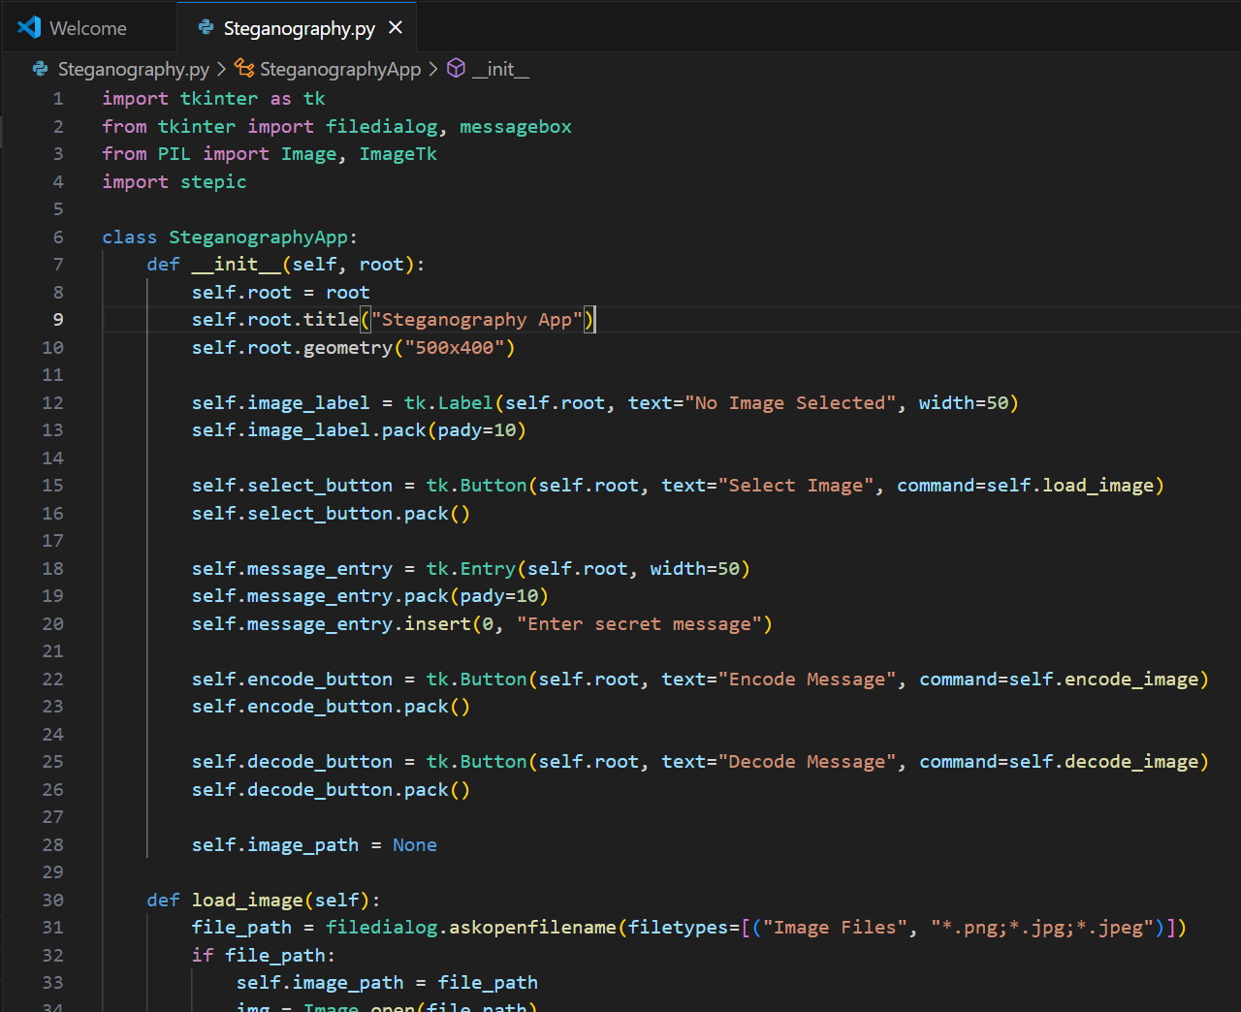
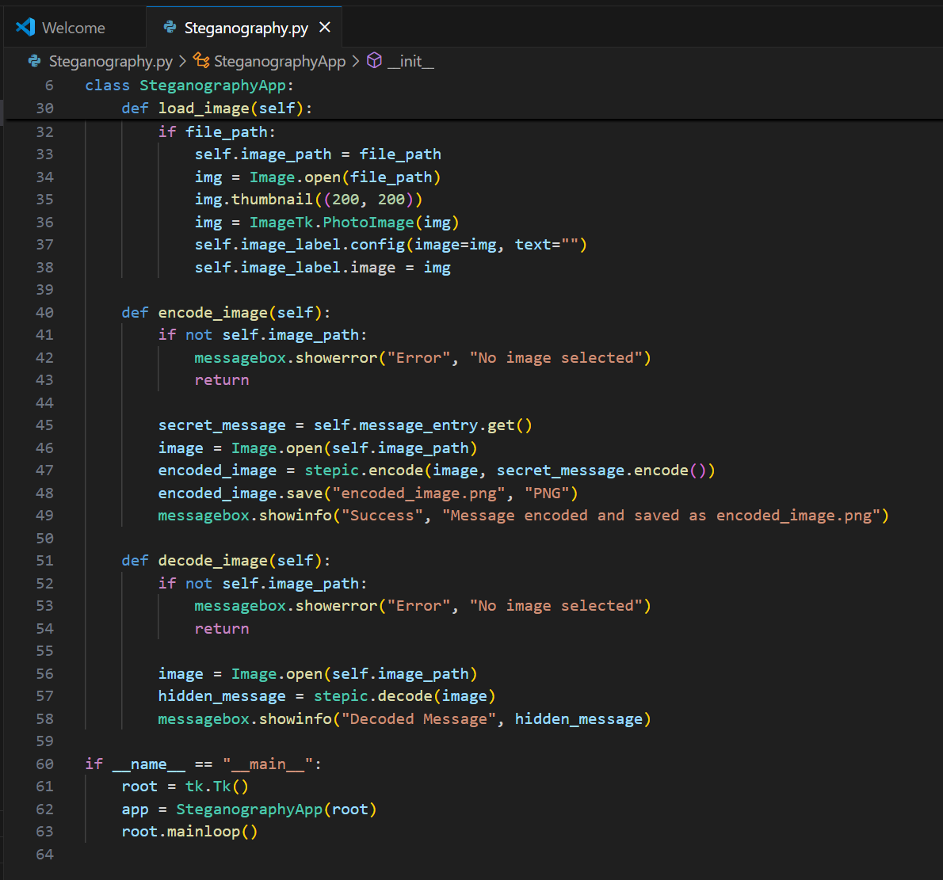
Results
Fig 1. Encryption, Decryption code

Slide 8
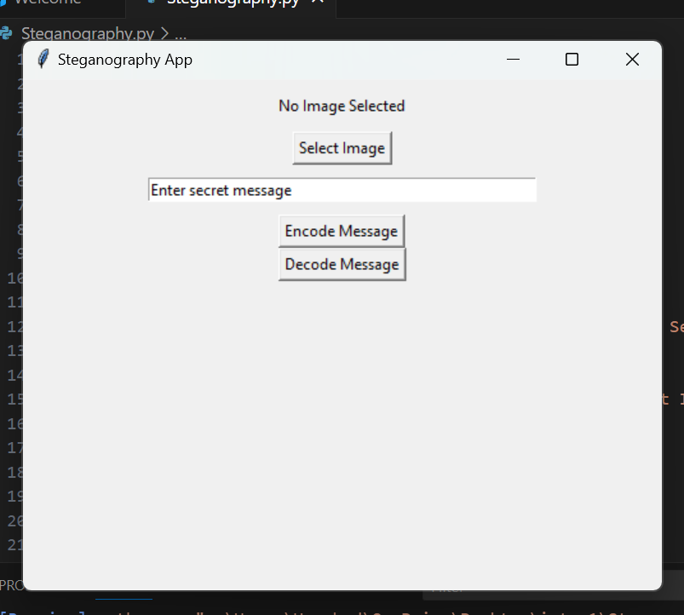
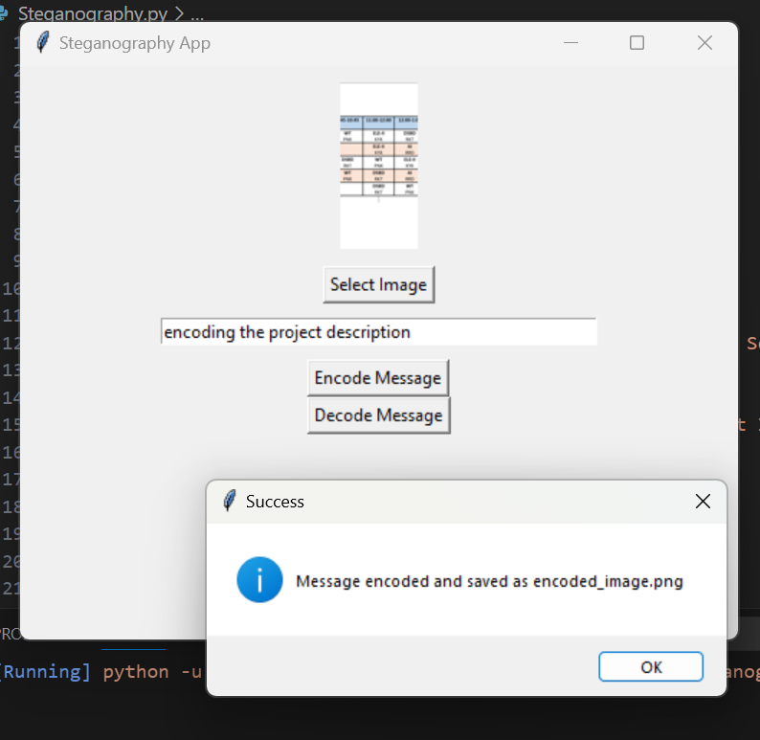
Results
Fig 2. Steganography App Page
Fig 3. Encryption Output

Slide 9
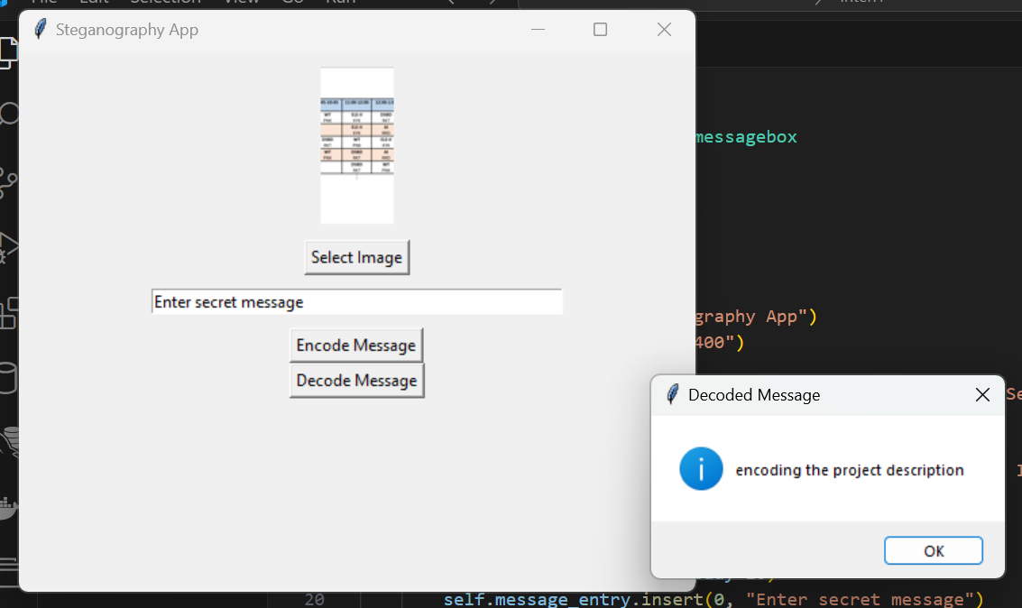
Results
Fig 4. Decryption Output

Slide 10
Conclusion
The project successfully implements LSB steganography for secure message hiding in images. The intuitive GUI makes encoding and decoding simple, ensuring confidential data transmission without altering the image visibly. Future improvements may include encryption, broader format support, and a web/mobile version for wider accessibility.

Slide 11
GitHub Link
https://github.com/Harshadw9/steganography-project

Slide 12
Future scope(optional)
Enhanced Security – Implement encryption before embedding messages for an extra layer of protection.
Web & Mobile Support – Develop a web or mobile version for accessibility across different platforms.
More Image Formats – Extend support beyond PNG and JPEG to include GIF, BMP, and TIFF formats.
Improved Robustness – Enhance the algorithm to withstand image compression and modifications.
Steganalysis Resistance – Strengthen techniques to make message detection even harder for attackers.

Slide 13
THANK YOU

